Slide 1
Hate speech detection using deep neural networks

Slide 2

Motivation

Slide 3

dataset
17k Tweets

Slide 4
classic approaches
Basic Naive bayes
Multinomial naive bayes
Logistic regression
Svm
Got up to 77% accuracy

Slide 5
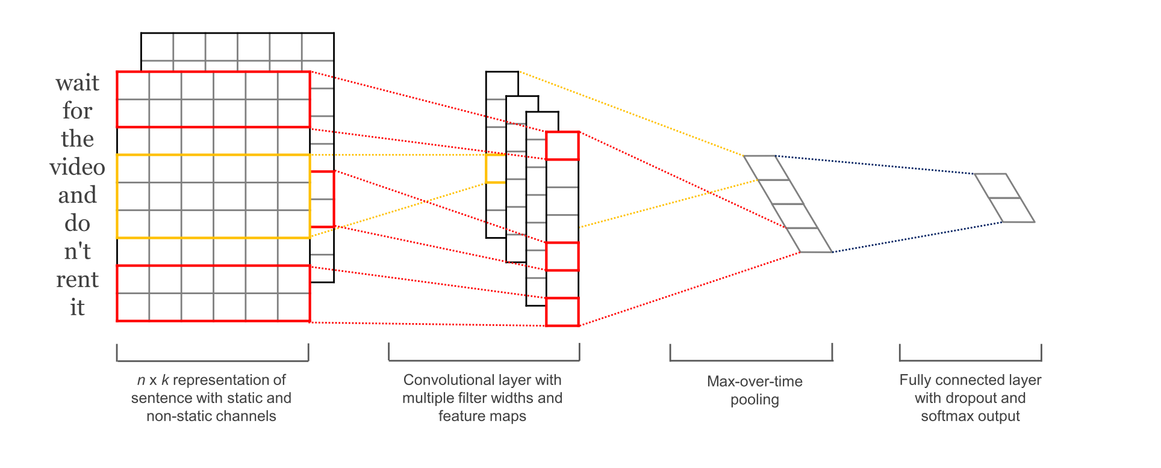
Convolutional neural network

Slide 6
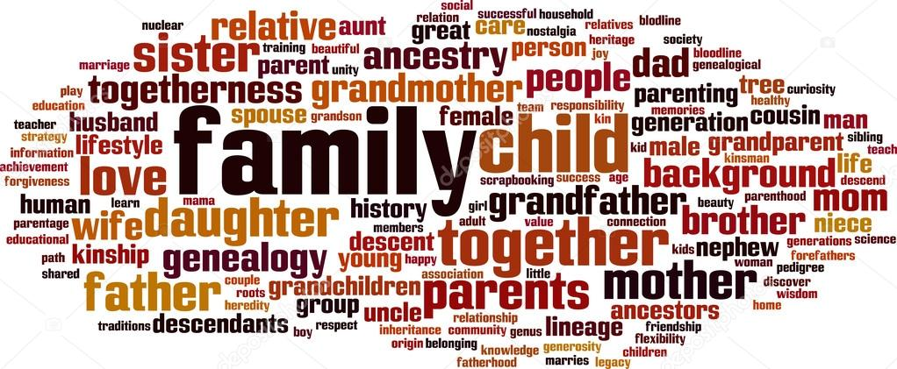
Word embedding

Slide 7
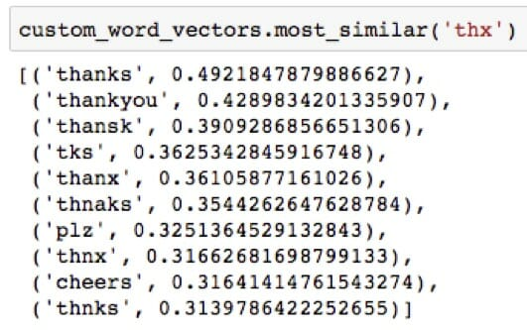
Word embedding

Slide 8
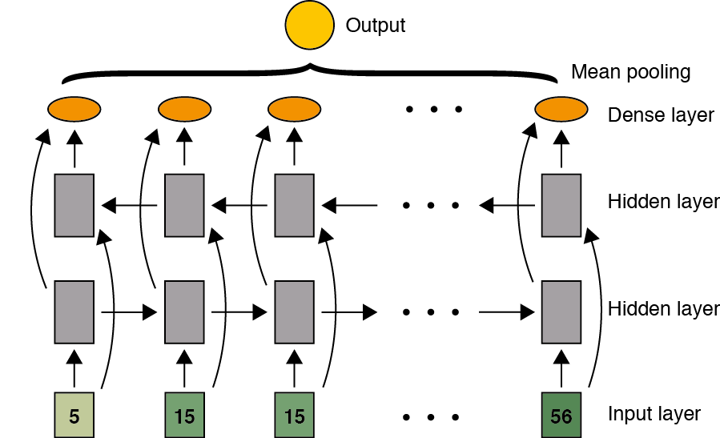
lstm

Slide 9
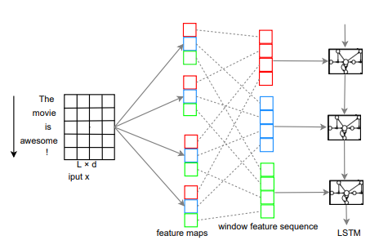
CNN + LSTM

Slide 10
Character level cnn
With a goal of extracting more semantic meaning..

Slide 11
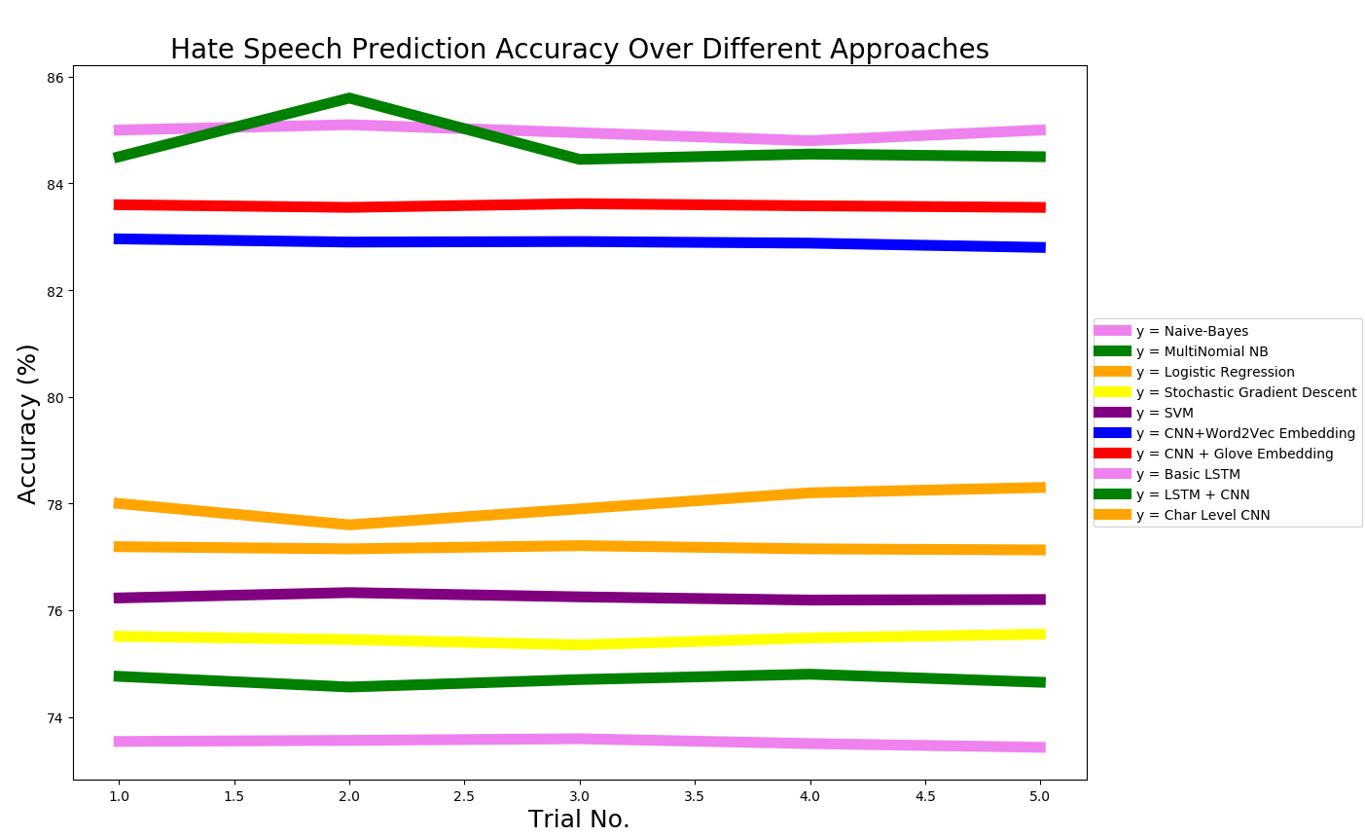
results

Slide 12
Thank you

